Slide 1
Task 2: Executive Summary
DSC 640-T301
Barbara Payne

Slide 2
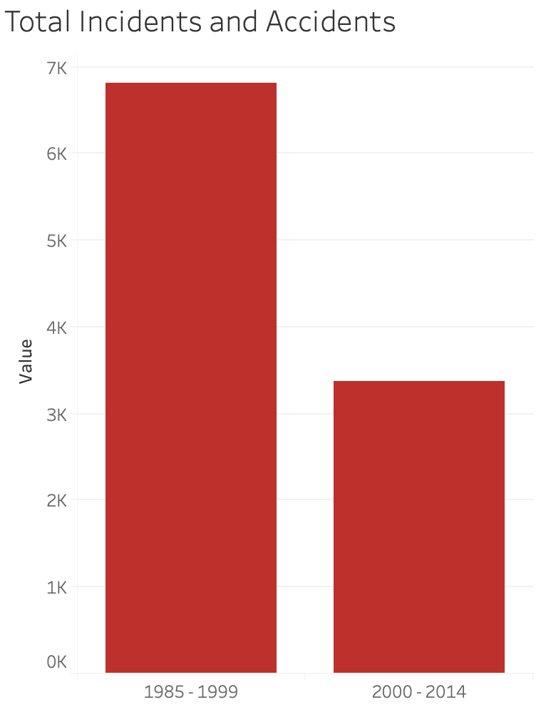

Slide 3
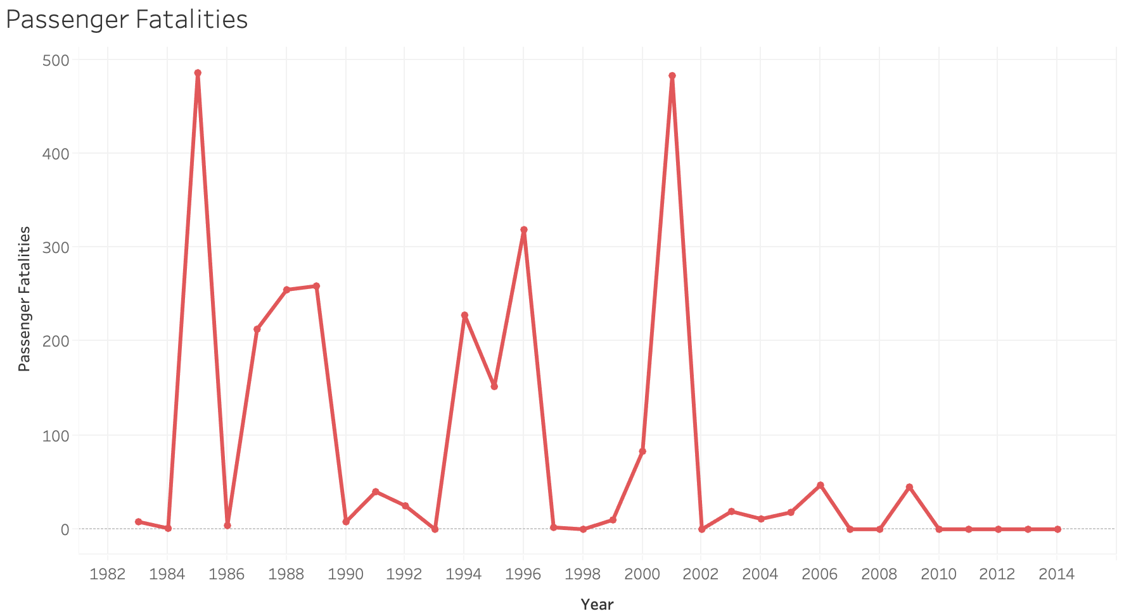

Slide 4
